Slide 1
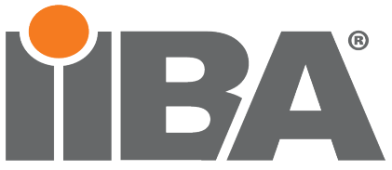
ATX Business Analysis Development Day (BADD)
SECURE YOUR EMPIRE
IIBA Austin, Texas Chapter Meeting, September 16, 2022
Stacy & Georgeo Pulikkathara

Slide 2
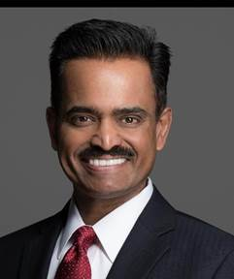
Georgeo Pulikkathara, Head of Security Operations at Bank of the West
George is a Chief Information Security Officer (CISO) with over 32 years of experience in the IT and IS industry across Wall Street, American International Group, Royal Bank of Canada Dominion Securities, Microsoft, Hewlett Packard Enterprise, Avanade, DataStax and now Bank of the West. George is currently Head of Security Operations at Bank of the West where he manages the Security Operations including Threat Intelligence Group, Cyber Security Incident Response, Cyber Security Operations Center, and the Red Team for penetration tests.
George is also currently a Lieutenant Colonel in the US Army Reserve, serving as the CIO/G-6 for the 81st Readiness Division, providing IT services for 50,000 Soldiers across 9 states in the Southeastern United States. George is very familiar with the Department of Defense (DoD) IT infrastructure, NIST, DFARS, and he holds an active Top-Secret SCI security clearance with the US Army, that is limited to less than 1% of US citizens. George has also served two combat duty tours with the US Army in Khost Afghanistan and Mosul, Iraq fighting in the Division main effort.

Slide 3
Stacy Pulikkathara, VP Business Analyst JP Morgan Chase, President IIBA Dallas Chapter
Stacy is a Vice President, Business Analyst for JP Morgan Chase Cyber Security Global Identity and Access Division, working on their Role Based Access Control (RBAC) management tools.
Former President of the Dallas Chapter IIBA
Master and Bachelor in Counseling Psychology
16 years of experience in the Project Management and Business Analyst world
10 years in the technology consulting business at Sally Beauty, Newell, Toyota, and now JP Morgan Chase

Slide 4
Cyber Security, What Business Analysts need to know
stacy pulikkathara | georgeo pulikkathara
SEPTEMBER 16, 2022

Slide 5
Agenda
Short History on Cryptography & Ciphers
Common Terminology used in Cyber security
Asset Identification and Valuation
Identity and Authentication and Authorization
Let’s Talk about Risk
How Companies organize their (Defensive) Cyber Security/Information Security(IS) teams
Global compliance requirements for data security & privacy
Common Threats and how companies protect themselves
Basic questions to ask when dealing with websites, application development and who to ask

Slide 6
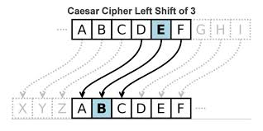
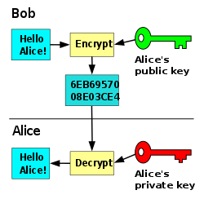
History of Cryptography, Information Services, & Cyber Security
The Scytale Transposition Cipher was used by the Spartan military in Ancient Greece.
Roman Generals routinely used the Caesar Shift Cipher to conceal information on troop movements and battle plans.
Substitution ciphers were used in Europe and the Indian continents.
Medieval times saw the use of custom rings/Seals and sealing wax to seal letters meant for its intended recipient only.
World War 2 saw the invention of the Enigma Code Machines used by the Germans.
United States Military used American Indian Code Talkers in the Pacific, North African and European theatres of war to encrypt troop movements in Lakota, Meskwaki, Mohawk, Comanche, Tlingit, Hopi, Cree and Crow native American languages that the Germans did not understand.
Today, a cipher is an algorithm for performing encryption or decryption—a series of well-defined steps that can be followed as a procedure.
Encryption - encryption is the process of encoding information. Today it’s takes the form of public key/private key and AES 256 encryption.
Scytale Transposition Cipher
Wax Seals/Sealing Wax

Slide 7
Common Terminology
Cyber Security – The conduct of defensive and offensive cyber security operations within cyberspace to exploit information assets or key cyber terrain.
Offensive Cyber Security –Conducted by US Gov’t by Presidential Policy Directive (PPD) 20; private sector not authorized to conduct offensive cyber security.
Defensive Cyber Security – Conducted by anyone looking to protect their data security and privacy; also known as Information Security or INFOSEC.
CIA Triad - Function of protecting the (Confidentiality, Integrity, or Availability) for an information asset.
Confidentiality - Protecting information from being accessed by unauthorized parties.
Integrity - Ensuring the authenticity of information.
Availability - Information is accessible by authorized users.
Availability
Confidentiality
Information Security
Integrity

Slide 8
Common Terminology (Cont’d)
Information Asset - A body of knowledge that is organized and managed as a single entity. Like any other corporate asset, an organization's information assets have financial value.
Data Owner – a Business or Organization that owns that data; can also be a senior business stakeholder within the organization.
Security Controls – People, Process or Technology implemented to reduce risk in information assets.
Vulnerability – Weakness in an information system, system security procedures, internal controls, or implementation that could be exploited or triggered by a threat source.
Threat Modeling - Process by which potential threats, such as structural vulnerabilities or the absence of appropriate safeguards, can be identified, enumerated, and mitigations can be prioritized.
Attack Surface - The sum of the different points where an unauthorized user can try to enter data to or extract data from an environment.
Availability
Confidentiality
Information Security
Integrity

Slide 9
Common Terminology (Cont’d)
Domain – a Logical grouping of computers, printers, and network resources.
Protocol - a set of rules for exchanging information: TCP/IP, IPX, NetBEUI, SS07
VPN – Virtual Private Network that allows a user to remain anonymous by masking their location and encrypting their network traffic
IP Address – Home address for your computer. Most organizations today use private IP addresses. IPv4 is a 32-bit address. IPv6 is a 128-bit address. Use ipconfig /all from a command prompt to see your IP addresses.
Patch management – The acting of keeping software and operating systems updated; Gartner and Microsoft studies have shown that 99% of the attacks where through a known vulnerability that was unpatched; the takeaway is that if it was properly patched, the attack could have been prevented.
Zero Day vulnerability – A zero-day (or 0-day) vulnerability is a software vulnerability that is discovered by attackers before the vendor has become aware of it. By definition, no patch exists for zero-day vulnerabilities and user systems have no defenses in place, making attacks highly likely to succeed.
Asymmetric Encryption - Public-key cryptography, different keys (Public Key encrypts, private key decrypts)
Symmetric Encryption - Is faster than asymmetric encryption and uses the same cryptographic keys for both encryption and decryption. Typically used for large volumes of data. AES 256 is an example.

Slide 10
Identification/Authentication/Authorization
Identification - The starting point for all access control as without proper identification it will not be possible to grant resources to any identity. The main objective of identification is to bind a user to appropriate controls based on the identity.
Authentication is the process of verifying the identity of a user. During Authentication process, the user provides some way of proving their identity to assert that the user is who they are claiming to be:
Something you know: Password, PIN,
Something you have: Token, pin & chip, smart phone, smart card (Government CAC card)
Something you are: Biometrics to include: finger print, palm print, facial recognition, iris scan, retina scan
Somewhere you are: Geolocation based authentication; phone and transaction take place in same location
Multi-Factor Authentication (MFA) - Usually combines two or more of the above to authenticate
Authorization - The final step in the process, and it allocates appropriate controls, privileges based on the identity in the system.

Slide 11
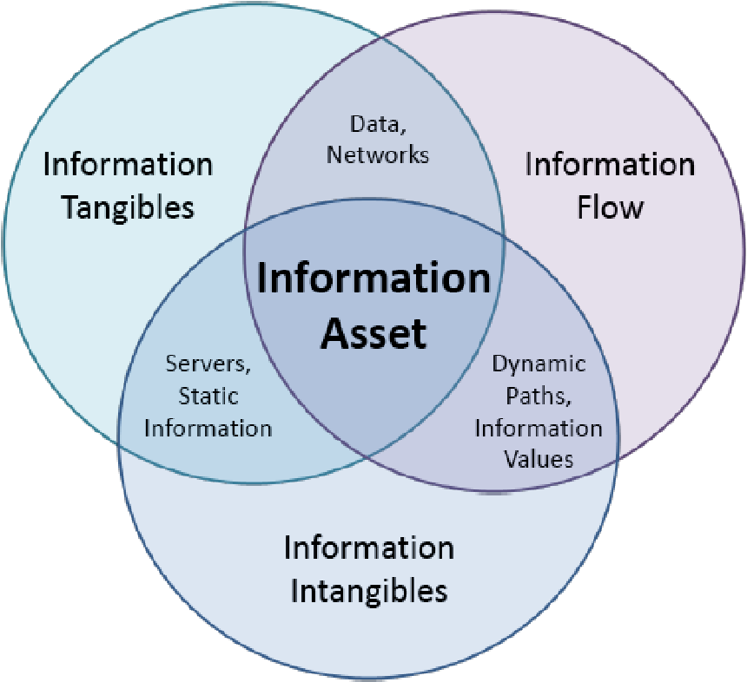
Asset Identification and Valuation
Asset Identification - All information Assets used to help the business survive
Asset Valuation Is this asset is stolen or lost, what’s the cost to the business?
Asset Risk identification Software / hardware vulnerabilities, compliance requirements, physical security requirements, etc.
Graphic is from a thesis paper from Denzil L. Hellesen , March 2008, “An analysis of information asset valution (iav) quantification methodology for application with Cyber information mission impact assessment (CIMIA).

Slide 12
Let’s Talk about Risk
Risk – Function of 1.) the probability that an attacker will exploit a vulnerability within a system, coupled with 2.) the impact or consequence of that attack
Risk Management - Identification, evaluation, and prioritization of risks followed by coordinated and economical application of resources to minimize, monitor, and control the probability or impact of unfortunate events or to maximize the realization of opportunities
Risk Assessment – Systematic process of evaluating the potential information security risks that may be involved in a project or portfolio of IT projects. Usually a quantifiable method is used to measure and prioritize information security risks
Risk Appetite - The level of risk that an organization is prepared to accept in pursuit of its objectives, before action is deemed necessary to reduce the risk
Risk Mitigation – Steps taking to reduce the adverse affects of risk, such as implementing security and privacy controls (People, Process or Technology)
Residual Risk - risk left over after security and privacy controls are applied to reduce information security risk in a project. Residual risk = (inherent risk – impact of security controls)

Slide 13
Risk Treatment Options
Risk Mitigation – Add more security and or privacy controls.
Risk Acceptance – Based on the organization’s risk appetite, they may choose to accept the risk or the residual risk after risk mitigation.
Risk Transference – Get Cyber Insurance to transfer the financial liability of the data breach to an insurance policy.
Risk Avoidance – Choosing not to operate in the current threat landscape.

Slide 14
Putting It All Together
Asset Valuation
Asset Discovery
Asset Valuation
Risk Treatment Options
Mitigate Risk to acceptable risk appetite levels for the business
Cyber Insurance
Security Controls applied should not exceed value of asset.
Use Cyber Insurance to cover the total asset value to the business. Ask the Data Owner for asset valuation.
Asset Identification
Accept the residual risk, or further mitigate, or transfer risk to a cyber liability insurance policy
Asset Data Classification

Slide 15
Recommended CISO Organization Structure
CISO
Security Engineering & Asset Security
Security Operations Center (SOC)
Emergency Operations and Incident Management
Program Management
Project Management Office
Vendor Risk Management
Governance Risk Compliance (GRC)
Information Security Executive Council
Deputy CISO
Security Engineering
Identify and Access Management
Application Security
Host & Network Security
Information Asset Security
Physical Access Control
ISO
ISO
ISO
* Structuring the Chief Information Security Officer Organization, Julia H. Allen, Gregory Crabb, Pamela D. Curtis, Brendan Fitzpatrick, Nader Mehravari, David Tobar; September 2015; Software Engineering Institute, Carnegie Mellon University, https://www.sei.cmu.edu
Notes:
Speaker Notes:
CISO Org structure:
This is from a Carnegie Mellon whitepaper, called “Structuring the Chief Information Security Officer Organization”, Julia H. Allen, Gregory Crabb (United States Postal Service), Pamela D. Curtis, Brendan Fitzpatrick, Nader Mehravari, David Tobar; September 2015; Software Engineering Institute, Carnegie Mellon University, https://www.sei.cmu.edu/.
This covers the four key functions of a CISO organization structure that we see in today’s modern CISO organizations. It’s important to note here that based on data gathered and from my own experiences, 50% the CISOs report into the CIO, 35% reporting into the COO or risk management leader, 15% into the CEO, with quarterly reporting to the board on the state of security across the business. In reality, it doesn’t matter where the CISO reports in. What matters is the ability to get things done and to quickly manage the information security risk to the organization. The data is from an article by Scott Koegler, https://securityintelligence.com/author/scott-koegler January 19, 2017.
Protect, Shield, Defend, and Prevent Ensure that the organization’s staff, policies, processes, practices, and technologies proactively protect, shield, and defend the enterprise from cyber threats, and prevent the occurrence and recurrence of cybersecurity incidents commensurate with the organization’s risk tolerance.
Monitor, Detect, and Hunt Ensure that the organization’s staff, policies, processes, practices, and technologies monitor ongoing operations and actively hunt for and detect adversaries, and report instances of suspicious and unauthorized events as expeditiously as possible.
Respond, Recover, and Sustain When a cybersecurity incident occurs, minimize its impact and ensure that the organization’s staff, policies, processes, practices, and technologies are rapidly deployed to return assets to normal operations as soon as possible. Assets include technologies, information, people, facilities, and supply chains.
Govern, Manage, Comply, Educate, and Manage Risk Ensure that the organization’s leadership, staff, policies, processes, practices, and technologies provide ongoing oversight, management, performance measurement, and course correction of all cybersecurity activities. This function includes ensuring compliance with all external and internal requirements and mitigating risk commensurate with the organization’s risk tolerance.

Slide 16
CISO Functions
CISO
Leading People
Leading Change
Managing Finance
Managing Supply Chain
Core Behaviors
Building Relationships

Slide 17
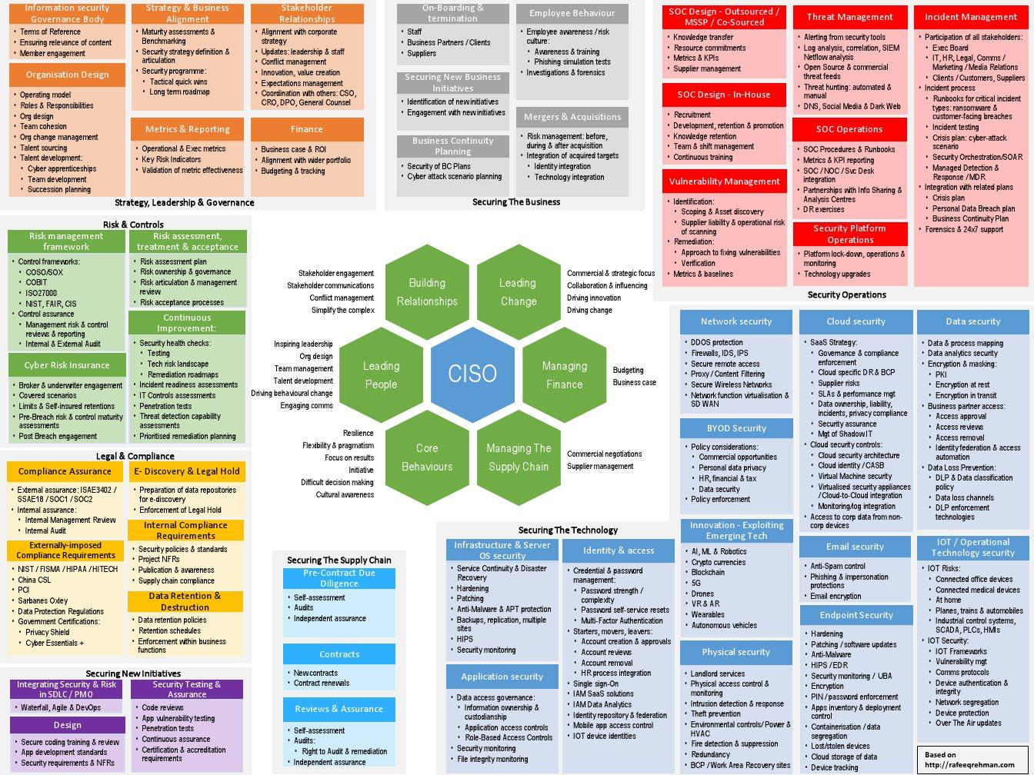

Slide 18
Global Compliance Requirements For Data Security & Privacy
regulations to be familiar with for data security and privacy
This Photo by Unknown Author is licensed under CC BY-NC

Slide 19
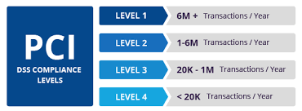
Payment Card Industry / Data Security Standard(PCI/DSS) – High Level Overview
Build and Maintain a Secure Network and Systems | 1. Install and maintain a firewall configuration to protect cardholder data 2. Do not use vendor-supplied defaults for system passwords and other security parameters
Protect Cardholder Data | 3. Protect stored cardholder data 4. Encrypt transmission of cardholder data across open, public networks
Maintain a Vulnerability Management Program | 5. Protect all systems against malware and regularly update anti-virus software or programs 6. Develop and maintain secure systems and applications
Implement Strong Access Control Measures | 7. Restrict access to cardholder data by business need to know 8. Identify and authenticate access to system components 9. Restrict physical access to cardholder data
Regularly Monitor and Test Networks | 10. Track and monitor all access to network resources and cardholder data 11. Regularly test security systems and processes
Maintain an Information Security Policy | 12. Maintain a policy that addresses information security for all personnel

Slide 20
Graham Leach Bliley Act (GLBA)
Organizations significantly engaged in providing financial products or services to consumers
Privacy Notice/Opt-Out Rights
Financial Privacy Rule
Safeguards Rule
FTC Enforcement
Pretexting Protection

Slide 21
California Consumer Privacy Act (CCPA)
Annual Gross Revenue> $25 Million
Annual Gross Revenue> $25 Million
For Profit Entity
Collects Personal Information (PI)
Determines the Purposes and Means of Processing
Does Business in California
CCPA Does Apply
OR
PI > 50,000 Consumers Annually
PI > 50,000 Consumers Annually
OR
Derives 50% of Annual Revenue from sale of PI
CCPA went into effect January 1, 2020

Slide 22
GDPR 6 DATA PROTECTION PRINCIPLES
1. Lawfulness, fairness, and transparency
2. Purpose limitation
3. Data minimization
4. Accuracy
5. Storage limitation
6. Integrity and confidentiality
GDPR COMPLIANCE /FINES
Data Protection Authority (DPA) decides:
Lower Level: €10 M or 2% of global revenue
Upper Level: €20 M or 4% of global revenue
DATA SUBJECT INDIVIDUAL RIGHTS
Right to be informed
Right of access
Right to rectification
Right to erasure
Right to restrict processing
Right to data portability
Right to object
Rights in relation to automated decision making and profiling

Slide 23
HIPAA Compliance

Slide 24
HIPAA Compliance (Cont’d)
National standards for electronic health care transactions
HIPAA Privacy Rule
Physical & technical controls
Data protection for healthcare organizations
Meet HIPAA and HITECH regulations for access, audit, integrity controls, data transmission, and device security
HIPAA Security Rule

Slide 25
HITRUST CSF 9.2
14 Control Categories, 46 Control Objectives, & 149 Control Specifications
Additional requirements for special segments
Detailed assessment guidance
Integrated online tool, MyCSF
Structured on ISO 27001:2005 & 27002:2005
Risk based framework
Composite framework of ISO, NIST, PCI, HIPAA, etc.

Slide 26
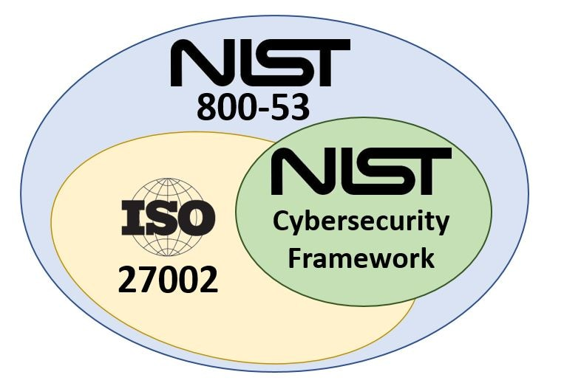
NIST 800-53, 800-37, 800-66
NIST 800-53 R4: Catalog of security & privacy controls | NIST 800-37 R2: Guideline for applying the RMF
NIST 800-53 R4: 26 security and privacy control families, 965 controls | NIST 800-66 R1: NIST HIPAA Security Rule Guide

Slide 27
Security Organizational Controls (SOC)
 | SOC 1 | SOC 2 | SOC 3 | SOC 4
Type 1 | Point in time financial audit on focuses on a service organization’s internal controls that can impact a customer’s financial statements | Point in time audit that focuses on controls relevant to compliance and operations, outlined by the AICPA’s Trust Services Criteria (TSCs). | Auditor attestation that a SOC 2 audit was done, and meets the principles of conformity, compliance, and security efforts for current or potential subscribers and customers of cloud services. | Made up Term
Type 2 | Over a period of time financial audit focuses on a service organization’s internal controls that can impact a customer’s financial statements | Over a period of time audit focuses on controls relevant to compliance and operations, outlined by the AICPA’s Trust Services Criteria (TSCs).
Restricted/unrestricted | Restricted | Restricted report | Unrestricted report
Trust Services Criteria: 1.) Security 2.) Availability 3.) Confidentiality 4.) Privacy 5.) Processing Integrity

Slide 28
Know the Threats… and how to protect
What does the current threat intelligence show for the industry that you work in?
iDefense, FireEye, Mandiant, ThreatConnect, FS-ISAC, all provide threat intelligence services for malware threats and cyber attacks are talking place on the threat landscape
Join FBI Infragard to get FBI Threat Intelligence data
Sign up for the Federal Cybersecurity Infrastructure Security Agency (CISA) alerts
Understand how attackers broke into a company or a malware was introduced into an organization
Understand that phishing attacks are the #1 attack vector for someone looking to steal information

Slide 29
Software Security Assurance
Microsoft Security Development Lifecycle (SDL)
https://www.microsoft.com/sdl

Slide 30
OWASP Top 10 2021
A01: 2021: Broken Access Control | A06: 2021: Vulnerable and outdated components
A02: 2021: Cryptographic Failures | A07: 2021: Identification and Authentication Failures
A03: 2021: Injection | A08: 2021: Software and Data Integrity Failures
A04: 2021: Insecure Design | A09: 2021: Security Logging and Monitoring Failures
A05: 2021: Security Misconfiguration | A10: 2021: Server-Side Request Forgery (SSRF)
https://owasp.org/www-project-top-ten/

Slide 31
Application Program Interface (API) Security
4 types of APIs
1.) Public – Internet Facing
2.) Private – Company Internal only
3.) Partner – Vendor / Partner supported
4. ) Composite – Hybrid models of the above

Slide 32
API Security Vulnerabilities
API1:2019 Broken Object Level
API2:2019 Broken User Authentication
API3:2019 Excessive Data Exposure
API4:2019 Lack of Resources & Rate Limiting
API5:2019 Broken Function Level Authorization
API6:2019 Mass Assignment
API7:2019 Security Misconfiguration
API8:2019 Injection
API9:2019 Improper Assets Management
API10:2019 Insufficient Logging & Monitoring

Slide 33
OWASP API Top 10 2019
API1:2019 Broken Object Level | API6:2019 Mass Assignment
API2:2019 Broken User Authentication | API7:2019 Security Misconfiguration
API3:2019 Excessive Data Exposure | API8:2019 Injection
API4:2019 Lack of Resources & Rate Limiting | API9:2019 Improper Assets Management
API5:2019 Broken Function Level Authorization | API10:2019 Insufficient Logging & Monitoring

Slide 34
As a BA, what do I ask?
What Information Assets does this project process, store, or transmit?
What’s the data classification for those assets and recommended security controls?
What security and privacy controls are in place to protect those information assets?
Who is the data owner/data custodian/data controller for those assets?
What security reviews need be done before the project goes live?
Who are those internal teams that need to be engaged to go live? Governance, Risk, Compliance teams? Cyber Security analysts? Penetration testing teams? Code scan teams? Data Security Legal?

Slide 35
As a BA, what do I ask?
What does the test data look like in the test environment?
Is the data being anonymized, pseudonymized, or tokenized?
Are the developers using production data in the test environment? Remember that the test environment doesn’t have the same level of security controls as the production environment.

Slide 36
As a BA, what do I ask? (Cont’d)
Is there a software security assurance or secure SDLC policy that needs to be followed to help reduce vulnerabilities in application development or web application development?
What data security &privacy compliance requirements need to be met in order for this website, project, or application to go live?
Has attack surface analysis been done already for this project? (Attack surface Analysis is what?)
Is there a threat model for this project? (What’s a threat model you ask?)
Establish source code versioning/Access controls, Follow Security code practices, Perform code reviews, Perform static code analysis, perform white box/black box testing, and remediate vulnerabilities, Ensure a Final Security Review is done and signed off the by risk owner before project goes live.

Slide 37
Thank You
Questions?

